Slide 1
Matrix Operations: Matrix Multiplication
In the case of an affiliation matrix:
  A_{(person x group)} X A^{T}_{(group x person)} = C_{(person x person)}
  A^{T}_{(group x person)} X A_{(person x group)} = C_{(group x group)}
A_{3 x 2} x A^{T}_{2 x 3} = C_{3 x 3}
A^{T}_{2 x 3} x A_{3 x 2} = C_{2 x 2}
Inner dims. match
Inner dims. match
Outer dims.
Outer dims.

Slide 2
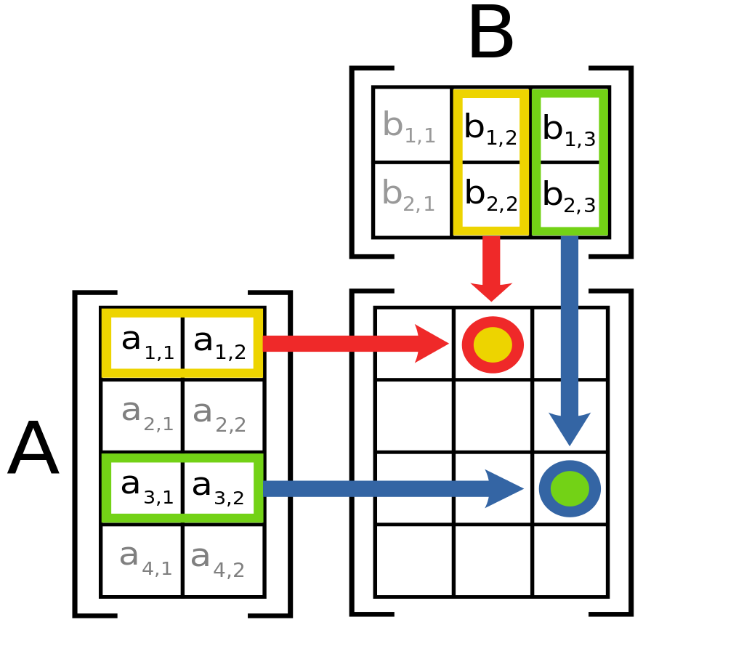
Matrix Operations: Matrix Multiplication
Properties of matrix multiplication:
  Not commutative!
    A X B ≠ B X A
    A X B can be defined but the reverse is no the case
  Associative:
    (A X B) X C = A X (B X C)
  Distributive over addition:
    A X (B + C) = (A X B) + (A X C)

Slide 3
Matrix Operations: Matrix Multiplication
Properties of matrix multiplication:
  Square matrices of the same dimension can always be multiplied
  A square matrix is one in which the row and column dimensions are of the same size
  Network adjacency matrices are square matrices
  You can take matrix powers by self-multiplication:
    A² = A X A
    A³ = A X A X A
    A^{k} = A X A X A ....(k times)

Slide 4


Undirected Graph
 | a | b | c | d | e
a | -- | 1 | 0 | 0 | 0
b | 1 | -- | 1 | 0 | 0
c | 0 | 1 | -- | 1 | 1
d | 0 | 0 | 1 | -- | 1
e | 0 | 0 | 1 | 1 | --
 | a | b | c | d | e
a | -- | 1 | 0 | 0 | 0
b | 1 | -- | 1 | 0 | 0
c | 0 | 1 | -- | 1 | 1
d | 0 | 0 | 1 | -- | 1
e | 0 | 0 | 1 | 1 | --
X
=
What happens if we take the second power of a network adjacency matrix?

Slide 5
What happens if we take the second power of a network adjacency matrix?
Undirected Graph
 | a | b | c | d | e
a | 0 | 1 | 0 | 0 | 0
b | 1 | 0 | 1 | 0 | 0
c | 0 | 1 | 0 | 1 | 1
d | 0 | 0 | 1 | 0 | 1
e | 0 | 0 | 1 | 1 | 0
 | a | b | c | d | e
a | 0 | 1 | 0 | 0 | 0
b | 1 | 0 | 1 | 0 | 0
c | 0 | 1 | 0 | 1 | 1
d | 0 | 0 | 1 | 0 | 1
e | 0 | 0 | 1 | 1 | 0
 | a | b | c | d | e
a
b
c
d
e
X
=
A_{5 x 5}
A_{5 x 5}
A²_{5 x 5}

Slide 6
What happens if we take the second power of a network adjacency matrix?
Undirected Graph
A²₁₃ = (0 * 0) + (1 * 1) + (0 * 0) + (0 * 1) + (0 * 1) = 1
 | a | b | c | d | e
a | 0 | 1 | 0 | 0 | 0
b | 1 | 0 | 1 | 0 | 0
c | 0 | 1 | 0 | 1 | 1
d | 0 | 0 | 1 | 0 | 1
e | 0 | 0 | 1 | 1 | 0
 | a | b | c | d | e
a | 0 | 1 | 0 | 0 | 0
b | 1 | 0 | 1 | 0 | 0
c | 0 | 1 | 0 | 1 | 1
d | 0 | 0 | 1 | 0 | 1
e | 0 | 0 | 1 | 1 | 0
 | a | b | c | d | e
a |  |  | 1
b
c
d
e
X
=
A_{5 x 5}
A_{5 x 5}
A²_{5 x 5}
To figure out which number goes in cell (1,3) of the target matrix we use the numbers from
row 1 of first matrix and column 3 of the second matrix and do same for each of the 25 (i,j) cells

Slide 7
There is a one in the ij of the squared matrix if and j are connected via a walk of length 2!
The diagonal is the number of walks of length 2 that begin and end at that vertex which equals degree!
Undirected Graph
 | a | b | c | d | e
a | 0 | 1 | 0 | 0 | 0
b | 1 | 0 | 1 | 0 | 0
c | 0 | 1 | 0 | 1 | 1
d | 0 | 0 | 1 | 0 | 1
e | 0 | 0 | 1 | 1 | 0
 | a | b | c | d | e
a | 0 | 1 | 0 | 0 | 0
b | 1 | 0 | 1 | 0 | 0
c | 0 | 1 | 0 | 1 | 1
d | 0 | 0 | 1 | 0 | 1
e | 0 | 0 | 1 | 1 | 0
 | a | b | c | d | e
a | 1 | 0 | 1 | 0 | 0
b | 0 | 2 | 0 | 1 | 1
c | 1 | 0 | 3 | 1 | 1
d | 0 | 1 | 1 | 2 | 1
e | 0 | 1 | 1 | 1 | 2
X
=
A_{5 x 5}
A_{5 x 5}
A²_{5 x 5}
Here’s the result (check here)

Slide 8
What happens if we take the third power of the adjacency matrix?
Undirected Graph
 | a | b | c | d | e
a | 0 | 1 | 0 | 0 | 0
b | 1 | 0 | 1 | 0 | 0
c | 0 | 1 | 0 | 1 | 1
d | 0 | 0 | 1 | 0 | 1
e | 0 | 0 | 1 | 1 | 0
 | a | b | c | d | e
a | 1 | 0 | 1 | 0 | 0
b | 0 | 2 | 0 | 1 | 1
c | 1 | 0 | 3 | 1 | 1
d | 0 | 1 | 1 | 2 | 1
e | 0 | 1 | 1 | 1 | 2
X
=
A_{5 x 5}
A²_{5 x 5}

Slide 9
Now we have all walks of length 3 between every node!
We can keep on going until we reach N (the graph order)
Undirected Graph
 | a | b | c | d | e
a | 0 | 1 | 0 | 0 | 0
b | 1 | 0 | 1 | 0 | 0
c | 0 | 1 | 0 | 1 | 1
d | 0 | 0 | 1 | 0 | 1
e | 0 | 0 | 1 | 1 | 0
 | a | b | c | d | e
a | 1 | 0 | 1 | 0 | 0
b | 0 | 2 | 0 | 1 | 1
c | 1 | 0 | 3 | 1 | 1
d | 0 | 1 | 1 | 2 | 1
e | 0 | 1 | 1 | 1 | 2
 | a | b | c | d | e
a | 0 | 2 | 0 | 1 | 1
b | 2 | 0 | 4 | 1 | 1
c | 0 | 4 | 2 | 4 | 4
d | 1 | 1 | 4 | 2 | 3
e | 1 | 1 | 4 | 3 | 2
X
=
A_{5 x 5}
A²_{5 x 5}
A³_{5 x 5}

Slide 10
Undirected Graph
Undirected Graph
 | a | b | c | d | e
a | 2 | 0 | 4 | 1 | 1
b | 0 | 6 | 2 | 5 | 5
c | 4 | 2 | 12 | 6 | 6
d | 1 | 5 | 6 | 7 | 6
e | 1 | 5 | 6 | 6 | 7
 | a | b | c | d | e
a | 0 | 6 | 2 | 5 | 5
b | 6 | 2 | 16 | 7 | 7
c | 2 | 16 | 14 | 18 | 18
d | 5 | 7 | 18 | 12 | 13
e | 5 | 7 | 16 | 13 | 12
W_{k = 4}
W_{k = 5}
Taking the k powers of an adjacency matrix A gives us a valued matrix W, where the w_{ij} is a measure of the multiple ways i can reach j via a walk of length k in the original matrix

Slide 11
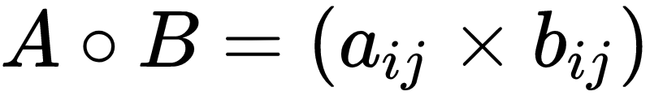
Matrix Operations: Matrix Multiplication
Element-wise matrix multiplication, also known as the Hadamard product (￮)
  Only defined for matrices with the same row and column dimensions
1 | 0 | 1
0 | 1 | 0
1 | 1 | 1
0 | 0 | 0
1 | 1 | 1
1 | 0 | 1
0 | 0 | 0
0 | 1 | 0
1 | 0 | 1
A _{3 x 3}
B _{3 x 3}
C_{3 x 3}

Slide 12
Matrix Operations: Matrix Multiplication
Matrix multiplication proper (✕)
  Only defined for conformable matrices
  Two matrices (e.g., A and B) are conformable if the number of columns of the first is the same as the number of rows of the second
A_{4 x 2} ✕ B_{2 x 3}
Number of Columns of the A matrix
Number of Rows of the B matrix

Slide 13
Matrix Operations: Matrix Multiplication
A_{4 x 2} ✕ B_{2 x 3}
A_{4 x 3} ✕ B_{2 x 3}
Inner dimensions
Inner dimensions
Outer dimensions
.
Outer dimensions
.
B _{2 x 3}
B _{2 x 3}
A _{4 x 3}
A _{4 x 2}

Slide 14
Matrix Operations: Matrix Multiplication
A_{4 x 2} ✕ B_{2 x 3}
A_{4 x 3} ✕ B_{2 x 3}
Inner dimensions match! Matrices are conformable
Inner dimensions don’t match! Matrices are not conformable
Inner dimensions
Inner dimensions
Outer dimensions
.
Outer dimensions
.
B _{2 x 3}
B _{2 x 3}
A _{4 x 3}
A _{4 x 2}

Slide 15


Matrix Operations: Matrix Multiplication
A_{4 x 2} ✕ B_{2 x 3}
A_{4 x 3} ✕ B_{2 x 3}
Inner dimensions match! Matrices are conformable
Inner dimensions don’t match! Matrices are not conformable
Inner dimensions
Inner dimensions
Outer dimensions
.
Outer dimensions
.
B _{2 x 3}
B _{2 x 3}
A _{4 x 3}
A _{4 x 2}

Slide 16
Matrix Operations: Matrix Multiplication
A_{4 x 2} ✕ B_{2 x 3}
A_{4 x 3} ✕ B_{2 x 3}
Inner dimensions match! Matrices are conformable
Inner dimensions don’t match! Matrices are not conformable
Inner dimensions
Inner dimensions
Outer dimensions
.
Outer dimensions
.
In general you can multiply any A_{m x n} matrix ✕ any B _{q x p} matrix:
  So long as n = q
  It doesn’t matter what the values of the outer dimensions is

Slide 17
Matrix Operations: Matrix Multiplication
A_{3 x 2} ✕ B_{2 x 4} = C_{3 x 4}
A_{3 x 2} ✕ B_{3 x 4} = Not defined
Inner dimensions
Inner dimensions
Product matrix C is 3 X 4 same as the outer dimensions
Outer dimensions
.
Outer dimensions
.
The outer dimensions determine the dimensions of the resulting matrix such that A_{m x n} ✕ B _{q x p} = C _{m x p}

Slide 18
Matrix Operations: Matrix Multiplication
a | b
c | d
e | f
g | h
=
a * e + b * g | a * f + b * h
c * e + d * g | c * f + d * h
X
2 x 2
2 x 2
2 x 2
How does it work?
For A X B:
  The ij cell of the resulting matrix is given by the sum of the product of the corresponding cells of row i in A and column j of B

Slide 19
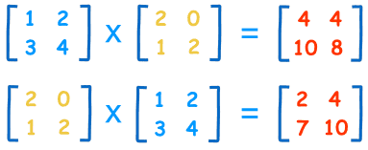
Matrix Operations: Matrix Multiplication
a | b
c | d
e | f
g | h
=
a * e + b * g | a * f + b * h
c * e + d * g | c * f + d * h
X
2 x 2
2 x 2
2 x 2

Slide 20
Matrix Operations: Matrix Multiplication
a | b
c | d
e | f
g | h
=
a * e + b * g | a * f + b * h
c * e + d * g | c * f + d * h
X
2 x 2
2 x 2
2 x 2
C₁₁ = (1 * 2) + (2 * 1) = 4
A
B
C

Slide 21
Matrix Operations: Matrix Multiplication
a | b
c | d
e | f
g | h
=
a * e + b * g | a * f + b * h
c * e + d * g | c * f + d * h
X
2 x 2
2 x 2
2 x 2
C₂₁ = (3 * 2) + (4 * 1) = 10
A
B
C

Slide 22
Matrix Operations: Matrix Multiplication
Properties of matrix multiplication:
  Not commutative!
    A X B ≠ B X A
    A X B can be defined but the reverse is no the case
  Associative:
    (A X B) X C = A X (B X C)
  Distributive over addition:
    A X (B + C) = (A X B) + (A X C)

Slide 23
Matrix Operations: Matrix Multiplication
Properties of matrix multiplication:
  Square matrices of the same dimension can always be multiplied
  A square matrix is one in which the row and column dimensions are of the same size
  Network adjacency matrices are square matrices
  You can take matrix powers by self-multiplication:
    A² = A X A
    A³ = A X A X A
    A^{k} = A X A X A ....(k times)

